Slide 1

CONSULTING & ADVISORY PRACTICE ASSIGNMENT
SUBMITTED BY: GROUP 1
GROUP MEMBERS:
SAVYASACHI JOSHI
PIYUSH DEVNANI
TUSHAR GUPTA
DAKSH KAPOOR
YASH VARDHAN AGARWAL

Slide 2
Situation
We the Bold consultancy services limited. are supposing our client is Dorman products inc. who is one of the largest manufacturers of precision steel components in automotive sector based out of United states and has a revenue of approximately $1 billion.
Amidst the turmoil and disruptions in the global supply chain in all the industries, steel wire industry is not exception, the natural calamities as well as the major geopolitical shifts around the globe are causing firms in various industries to undergo research projects to gain business intelligence that will enable them to charter through these unpredictable global supply chain waters.
This is a similar project in which we are sending a proposal to the client stating the basic findings in the industry with the various ongoing trends along with the recommendations about how to move forward. (Steel wire is the basic and the most crucial raw material for the Dorman products inc., hence they want insights from this industry)

Slide 3

EXECUTIVE SUMMARY
US steel wire market touched USD 6.58 billion in 2021, with a CAGR of 4.5%
Amidst the Russia-Ukraine war and pandemic the industry is showing brighter prospects of growth.
Export prices have gone up.
Domestic supply in the country is unable to meet the internal demand.
US imports almost 60% of its pig iron from Russia and Ukraine.
New strategies should be implemented in managing the inventories and supply chain as now is the time for diversification.

Slide 4
OPPORTUNITIES & SOLUTIONS
Opportunities:
Increase in revenue stream, as the size of the US steel wire market is USD 6.58 billion, even capturing 0.5% of market share would lead to an increase of more than USD 30 million in revenue.
A steady supply of steal wire for the core components manufacturing business, this is essential as the supply chains are disrupted across the globe.
Solutions:
Going for opening a steel wire manufacturing plant
M&A projects, since covid has adversely affected many medium and even some large size firms, hence they are looking to merge or even be acquired in order to sustain.

Slide 5
CONTEXT
Export Outlook:
The value of export has risen before the pandemic era, but the quantity of export is same as pre pandemic level which shows that the price of steel wire have been increased.
Import Outlook:
The price of the import and as well as the quantity has risen up showing that the domestic demand cannot be fulfilled internally.
The Automotive industry which has significant share in driving the demand is also showing healthy growth which in turn rises the demand.
labour Shortage:
The labour shortage is also a major issue faced by the industry.
Increasing number of aged labour and youth doesn’t want to work in manual industry.
Many players are going with automation hence not depending too much on labour.

Slide 6
EVALUATION OF OPTIONS
Investing in new Steel Wire Manufacturing Facility
Long term gain.
Steady supply of steel wire for core business.
High initial investment.
Shift of focus from core business (temporarily).

Slide 7
EVALUATION OF OPTIONS
Going for Mergers and Acquisitions with the existing players
Less time consuming as compared to first option
Will be ready to manufacture steel wire much earlier as compared to first option
Compatibility issue of organizations may arise
Complex legal procedures

Slide 8
EVALUATION OF OPTIONS
Automation in Manufacturing Processes
Strategically important, as with the advent of industry 4.0, all manufacturing is set to be automated.
Will increase manufacturing efficiency and waste reduction.
Will increase product quality
Will require re skilling of workers or hiring new ones.
Will require large number of initial investments.

Slide 9
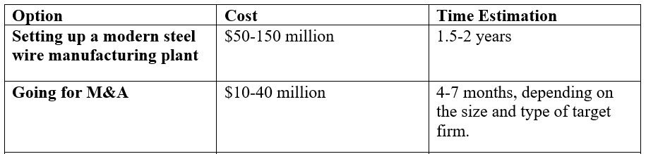
Cost and time estimation of options being considered:

Slide 10
RECOMMENDATIONS
To deal with steel wire supply problem we suggest Dorman Products to go for a Mergers and Acquisitions project (M&A)
For this purpose, firstly we need to decide on the target firm, (the steps for which have been explained in the action stage).
After selecting the target firm and confirming which of them is ready to go for M&A.
Contact them via your legal department.
Go for a due diligence of their background check.
Study their culture, operations, finances, history etc. to check for compatibility with your company.
Make a legal contract and agreement for M&A.
Finally execute M&A.

Slide 11
ACTIONS
The following steps explain how to go for the brown field or M&A project.
Make an Exhaustive list of all the target firms for the M&A project.
Make the profile of target firms by collecting information on selected important parameters.
Evaluate the target firms by rating them on selected parameters.
Come out with a final rating score of the target firms.
Choose from the top-rated firm to go for M&A.

Slide 12
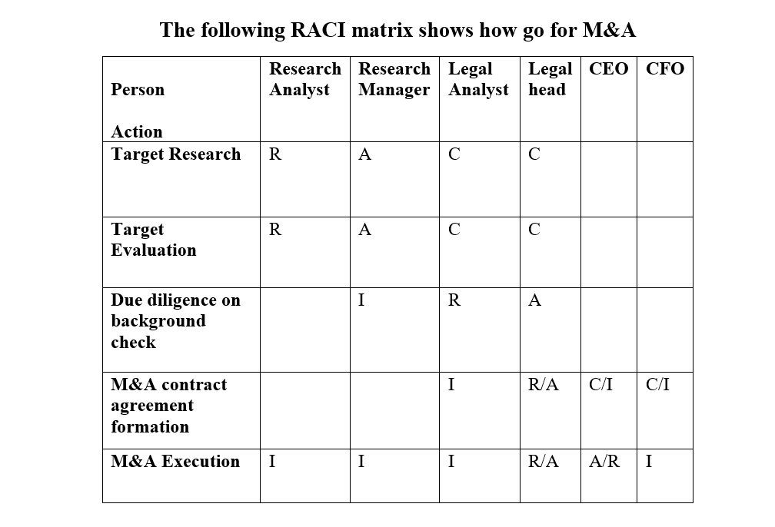
ACTIONS cont..
The following RACI matrix shows, who is responsible, accountable for a task as well who needs to be consulted and informed

Slide 13
APPENDIX
https://www.trademap.org/Index.aspx
https://comtrade.un.org/
https://www.bls.gov/
https://www.globenewswire.com/news-release/2020/05/22/2037777/0/en/Steel-Wire-market-worldwide-is-projected-to-grow-by-US- 6-6-Billion.html
https://smihq.org/page/AboutUs
https://www.ibisworld.com/
https://www.casmi-springworld.org/
https://data.oecd.org/
https://worldsteel.org/
https://www.metalbulletin.com/Article/5086927/US-pig-iron-import-market-surges-on- Ukraine-Russia-conflict.html

Slide 14
SWOT ANALYSIS
T
Large market cap and one of the biggest player in the industry.
Multiple manufacturing facilities available throughout the US.
W
The increasing demand of steel wire in the US and the world.
Enhancing manufacturing with automation becoming cheaper.
Players are merging for strategic advantage and giving tough competition competitors.
Disrupted supply of crucial raw materials for steel wire manufacturing.
Slow manufacturing process.
Vulnerable to supply chain disruptions.
O
S

Slide 15
PESTEL ANALYSIS
Legal
New tariff agreement laws with UK
An appeal by American iron and steel institute to amend the America Competes Act, to tackle trade challenges presented by China’s cross border subsidization
High inflation in the US markets
High probability of recession in the US
Slow GDP growth will hamper the economy
Technology
Increasing adoption of automation technology in manufacturing.
P
Economical
T
L
S
E
E
Political
Shift towards revitalizing the manufacturing .
High import duties on steel and steel mill products promote domestic consumption.
Social
Investors becoming conscious of ESG factors while investing in firms
Environment
Increasing global warming calls for tighter emission restrictions.

Slide 16
KEY ASSUMPTIONS
During this research it was assumed that US economy might go into recession which was backed-up by the Bloomberg research but that can’t be 100% sure.
The steel wire business is directly influenced by the steel production sector in the United States. We hypothesized that because steel wire is a specialized business with little statistics available, we used comparable and equivalent proxies from the US steel wire industry.
Manufacturing in the United States and, more broadly, most nations across the world has restarted following the pandemic; we must presume this because Covid is still spreading in places like China, which may impede production locally, but it has resumed in the United States.
One of the presumptions was that since steel wire is directly impacted by the steel industry, the relevance of PESTLE factors would be the same for both industries. This is because steel wire is a very niche market, and factors that directly affect it could not be sequestered when conducting the PESTLE analysis.
Since the project's scope prevents us from going into too much depth during the RACI analysis of activities, we assumed that one person may be both accountable for and liable for a job in some situations.

Slide 17
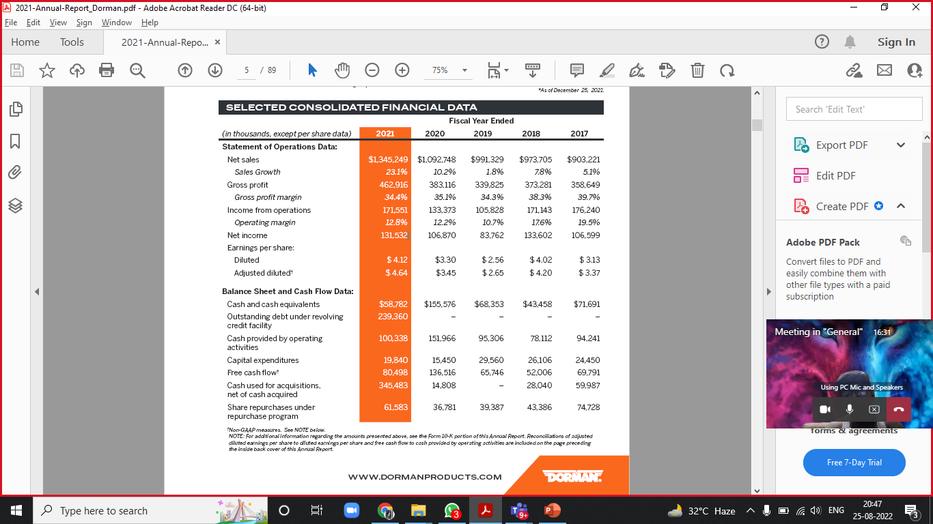
Financials
This is the 5-year Account Statement.
Showing Turn-Over of the Company.

Slide 18
FORECASTING REVENUE FOR YEAR 2022
As we recommend Dorman Products for M&A by doing so, they would be able to capture 1% of market share. Hence their revenue would increase by USD 60 Million.
By acquiring a raw material firm, they will be able to reduce their operating cost as their major chunk of funds goes away in collecting raw materials for the finished goods.
We the Bold Consultancy Pvt. Ltd are charging a fees of 2% on the revenue addition by the firm through M&A.

Slide 19
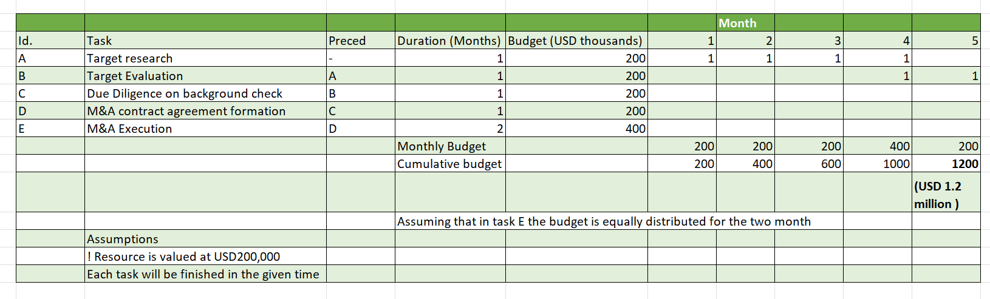
Time phased project budget

Slide 20
Key Risks
Setting up a new steel wire manufacturing facility would incur high capital expenditure in start and making it profitable might take longer than expected.
Current labor might be reluctant in training for working with automation technology.
The cost of hiring trained labor for working with automation technology might get higher than the anticipated returns from adopting automation.
Compatibility issues might lead to unsuccessful mergers.

Slide 21
Organization chart
IT/Cloud Consulting head
Finance consulting head
Risk , brown field Consulting head
Quality ,green field, manufacturing consulting head
Supply chain and procurement consulting head
Team 1
Team 1
Team 1
Team 1
Team 1
Team 2
Team 2
Team 2
Team 2
Team 2

Slide 22
How the organization structure will imply to this project
Risk , brown field Consulting head
Client facing (Point of contact)
Team 1
Research manager
Research Analyst
Team 2
Legal head
Legal Analyst

Slide 23
Legal / Regulatory / other specialist opinions:
ESG related legal and regulatory requirements for commercial manufacturers.
ESG reporting regulations to become stringent in the USA in coming year or two. Albeit currently USA does not have laws or legal requirements for reporting ESG at the Federal level as of now, (which is unlike Europe), yet the SEC (Securities and Exchange Commission) in the March of 2021, announced creation of a climate and ESG task force to enforce adherence to regulations related to climate risks.
The Financial stability oversight council (FSOC), which is comprised of heads of various federal agencies like the Treasury, SEC, the Federal reserve board, and the Office of Comptroller of the Currency (OCC), recently issued a report on climate related financial risk, among other things also calls for new disclosures in financial statements, the report endorses building on the core concepts of the (TCFD), Task force on Climate related Financial Risks.

Slide 24
other specialist opinions:
5 Important points to consider post-M&A projects.
Distinguish between long term resource needs versus one-time, deal-specific needs.
Take advantage of the M&A window as the company is in a dynamic phase and organizational changes can be implemented easily unlike in other times.
Ensure smooth integration of people, departments, and cultures.
Learn to identify and deploy the right resources at right time.
Most M&A fail because of unsuccessful integration of work cultures of some firms, hence take care of cultural unification.

Slide 25
Global Steel Wire Market Outlook.
Market size, growth ,Key demand drivers and inhibitors in the industry (2021).
The global steel wire market size was USD 91.33 billion in 2018 and is projected to reach USD 112.14 billion by 2026, exhibiting a CAGR of 2.7% during this period.
Key drivers of demand in the industry.
Key Inhibitors of demand in the industry
Effective substitutes of steel wires which are made from either plastics or hybrid materials.
The disruptions in global supply chains for Raw materials due to Russia Ukraine war
The Covid-19 pandemic.
Resurgence of demand in automotive industry around the world post covid-19 pandemic.
High rate of infrastructure development in developing countries like India, Brazil, China.

Slide 26
The United States Steel Wire Market Outlook
Market Value and Volume
The value of US steel wire market was USD 6.3 billion in 2020, with a CAGR of 4.5% for 2020-2027 period, this means that in 2021 US steel wire market was worth approximately USD 6.58 billion .
The price range for steel wires in USA was USD 1150 to 1210 per tonne in 2021, taking an average we get USD 1180 per tonne price of steel wire in 2021.
Value of US steel wire market in 2021 was USD 6.58 billion.
Average price of steel wires in USA in 2021 was USD 1180 per tonne
Hence the volume of steel wire market in USA in 2021 was approximately 5.58 million tonnes
According to report of world steel association, USA produced 86 million tonnes worth of steel in 2021 which was a growth of 18.3% from 2020 level.
Hence total steel wire production as a percentage of total crude steel produced in USA in 2021 was approximately 6.5%.

Slide 27
US Steel wire import and export outlook
Export
Import

Slide 28
Demand in the United States Steel Wire Industry.
US Steel wire demand forecast.
Pandemic lead to sudden halt in manufacturing.
Thus, there was a pile up and backlog of orders in steel wire industry.
After the lockdown, the steel wire demand saw sudden resurge
One of the key drivers of steel wire demand in the US is the automotive manufacturing sector.
It must be noted that the forecast is subject to high uncertainty due to factors like the Russia Ukraine war and the pandemic.
The decline in the growth rate in 2022 is due to the Russia Ukraine war.
While it is bound to resurge in 2023.

Slide 29
Labor Shortage in the industry
Age wise employment in the US steel wire (Thousands)
The shortage can be attributed in part to the following
Layoffs due to the pandemic caused reduction in revenue and profit.
There were more numbers of older people in the industry who are now retiring, while the younger generation does not want to this kind of manual work in noisy factories.
Adoption of automation.

Slide 30
Impact of Russia Ukraine war on the market
Dependence of US on Russia and Ukraine
Other sources not reliable
High cost of steel wire manufacturing
Increase in steel wire prices

